Slide 1
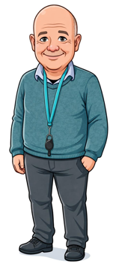
10) ESCCCP24 2025-2026 14 May 2026

Slide 2
Check-in
Thu 14 May 2026

Slide 3
Work from Thu 7 May 2026
FEC Booklet FCE Reading.pptx with FCE Reading.pdf,
We did an First Certificate Reading paper to explore different ways of approaching reading.
Part 1: identified the main points in a text. This aligns exactly with Ascentis criterion 1.1 which is identically worded.
Part 2: detailed understanding of a text including opinions and attitudes expressed in it.
Part 3 developed our ability to analyse text structure. Although this aligns most closely with Ascentis criterion 1.2, the criterion does not fully capture this reading skill, as criterion 1.2 focuses only on identifying main events.
Les Dawson 'The Night Sky' – YouTube helped us understand the expression “down to earth” in a humourous way. After expressing wonder at the night sky and the size of the universe, he realises that he needs to get a roof put on his outside toilet.
Homework
FCE Reading.pdf Part 4: A Place to Play
Extra Practice
B2 reading | LearnEnglish

Slide 4
Reading & Writing
17:45 – 20:45

Slide 5
Complaint
Progress Test 2

Slide 6
Check-out
Thu 7 May 2026

Slide 7
Using Plus FCE Complaint, we
learnt to write an email of complaint
Using Progress Test 2, we
began the progress test.
Homework
Plus FCE Complaint p. 68. Write an email of complaint for Kim’s Wonder Diet. See the next two slides.

Slide 8
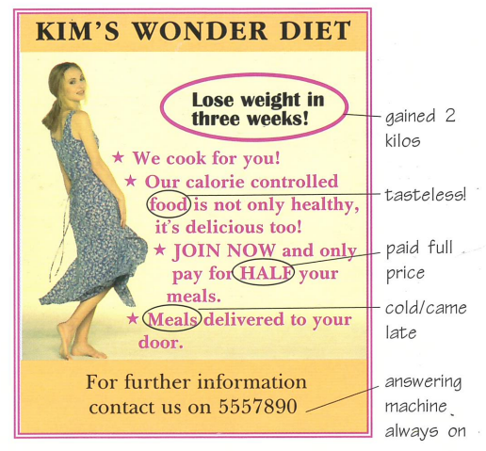

Slide 9
3 Task for homework.
Write the email of complaint using the plan you made in exercise 2.

